Slide 1
Prompt Management

Slide 2
Introduction to Messages
Message Content and Naming
Message Types Overview
Prompt Templates Overview
Few Shot Prompts

Slide 3

Introduction to Messages
Components of a Message:
Role: Describes who is sending the message.
Content: The actual content of the message.
Response Metadata: Optional additional metadata.
Standard Roles:
User
Assistant
System
Tool

Slide 4
Message Content and Naming
Content Types:
String: Most common content type.
List of Dictionaries: Used for multimodal input.
Name Property:
Differentiates between multiple speakers with the same role.
Useful in chats with multiple users.

Slide 5


Message Types Overview
There are 4 standard message roles in LangChain Core: User, Assistant, System, and Tool.
HumanMessages represent messages with the role 'user'.
AIMessages represent messages with the role 'assistant' and include tool calls and response metadata.
SystemMessages represent messages with the role 'system' and instruct the model on how to behave.
ToolMessages represent messages with the role 'tool' and include tool call IDs and additional artifacts.
FunctionMessages are a legacy message type and should be replaced with ToolMessages.
Notes:
This slide provides an overview of the different message types presented in the LangChain Core. Each type of message has a unique role and purpose within the conversation. Understanding the different message types is crucial for effective use of LangChain Core.

Slide 6
Prompt Templates Overview
Purpose:
Translate user input and parameters into instructions for a language model.
Input:
A dictionary with keys representing variables to fill in.
Output:
A PromptValue that can be passed to LLMs or ChatModels.

Slide 7
String PromptTemplates
Usage:
Format a single string for simpler inputs.
Example:
from langchain_core.prompts import PromptTemplate
prompt_template = PromptTemplate.from_template("Tell me a joke about {topic}")
prompt_template.invoke({"topic": "cats"})

Slide 8
ChatPromptTemplates
Usage:
Format a list of messages.
Example:
from langchain_core.prompts import ChatPromptTemplate
prompt_template = ChatPromptTemplate.from_messages([
("system", "You are a helpful assistant"),
("user", "Tell me a joke about {topic}")
])
prompt_template.invoke({"topic": "cats"})

Slide 9
MessagesPlaceholder
Purpose:
Add a list of messages at a specific point in the prompt.
Example:
from langchain_core.prompts import ChatPromptTemplate, MessagesPlaceholder
from langchain_core.messages import HumanMessage
prompt_template = ChatPromptTemplate.from_messages([
("system", "You are a helpful assistant"),
MessagesPlaceholder("msgs")
])
prompt_template.invoke({"msgs": [HumanMessage(content="hi!")])

Slide 10
Alternative to MessagesPlaceholder
Using Placeholder Directly:
prompt_template = ChatPromptTemplate.from_messages([
("system", "You are a helpful assistant"),
("placeholder", "{msgs}")
])
Note:
- Achieves the same result without explicitly using MessagesPlaceholder.

Slide 11
Few Shot Prompts
Purpose:
Dynamically select examples for few-shot prompting.
Benefits:
Provides concrete examples to guide model behavior.
Enhances relevance and coherence in model output.
Example:
Few_shot_prompt = f”””
Example 1: Word: happy Synonym: joyful
Example 2: Word: big Synonym: large
Example 3: Word: fast Synonym: quick
Example 4: Word: smart Synonym:
“””

Slide 12
Few Shot Prompts Using Selectors
Example Selector (this can be built dynamically from a different source):
examples = [
{"input": "hi", "output": "ciao"},
{"input": "bye", "output": "arrivederci"},
{"input": "soccer", "output": "calcio"},
]
Reference:
https://python.langchain.com/docs/how_to/example_selectors/
prompt = FewShotPromptTemplate(
example_selector=example_selector,
example_prompt=example_prompt,
suffix="Input: {input} -> Output:",
prefix="Translate the following words from English to Italian:",
input_variables=["input"],
)
print(prompt.format(input="word"))

Slide 13
Conclusion
Key Takeaways:
Understanding message roles and structures is crucial.
Prompt templates are powerful tools for guiding language models.
Effective use of these concepts improves model performance and output quality.

Slide 14
Q&A

Slide 15
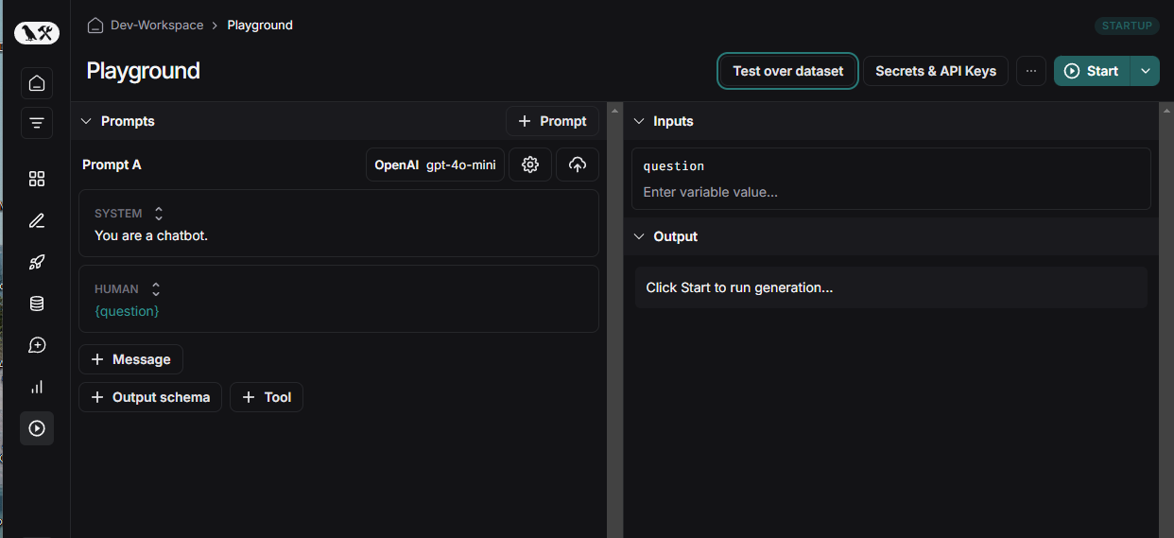
Coding Exercise
> https://smith.langchain.com > Playground

